Slide 1
T-Mobile Sell With Partners
Work with a Partner,
not just a
Vendor.
Your LTE Connectivity Specialists

Slide 2
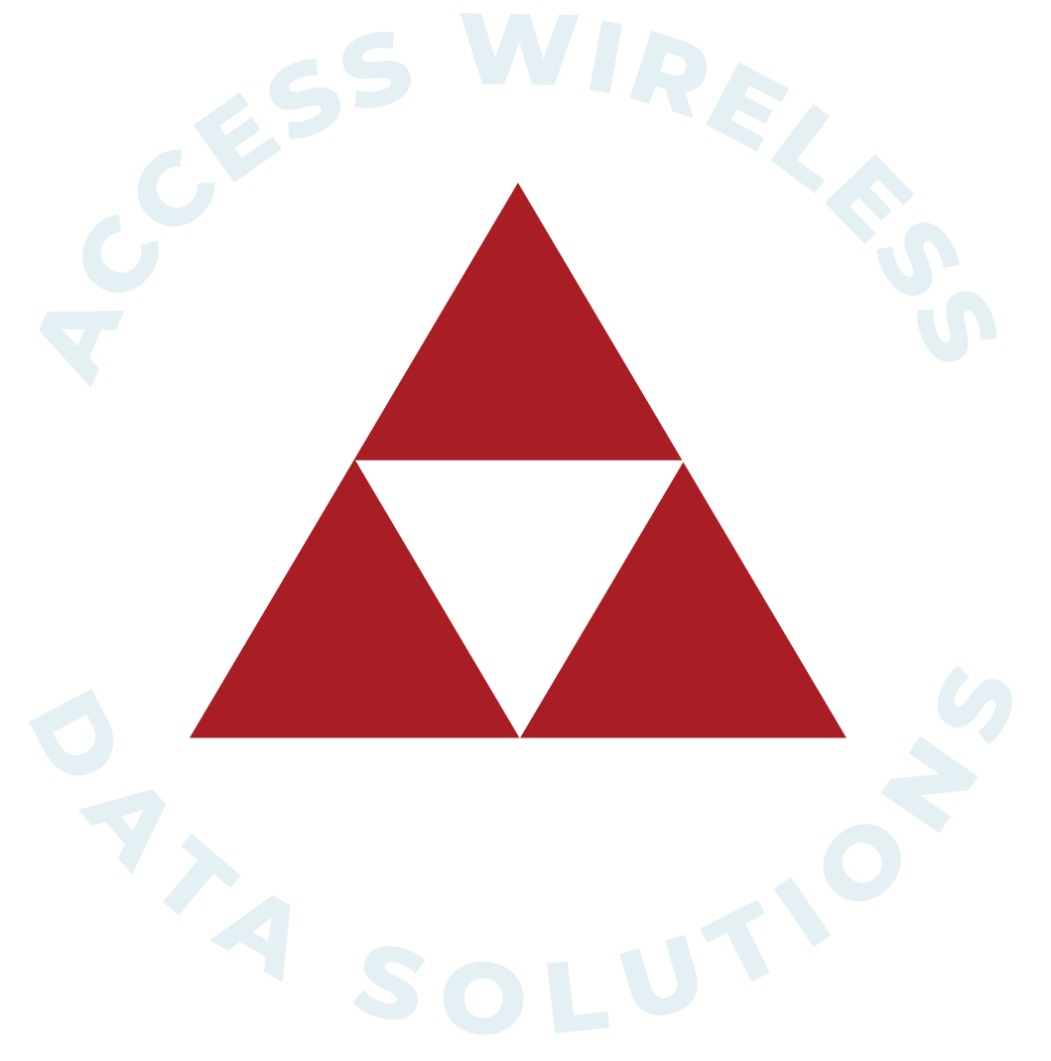
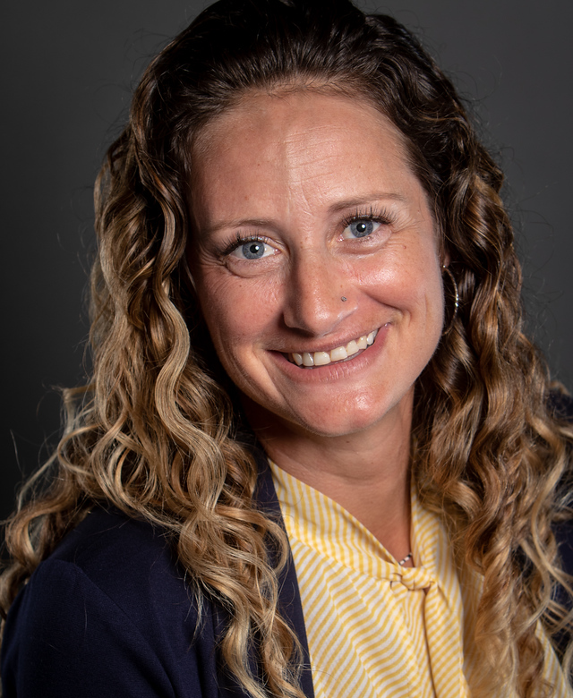
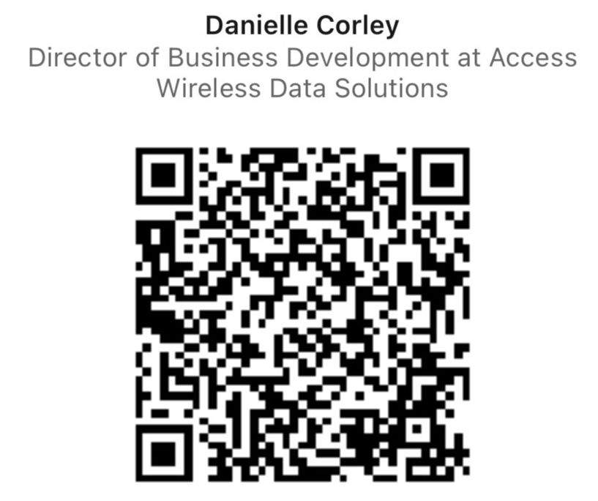
Meet your speakers…
Let’s connect on LinkedIn
Danielle Corley –
Director of Business Development
DanielleC@accesswds.com
813-751-2039 x107
Phil Patterson –
National Channel Business Manager
PhilP@accesswds.com
813-751-2039 x121

Slide 3
Who is AWDS?
Work with a PARTNER, not just a vendor.
Value-added reseller experienced in cellular connectivity for over 16-years
Company solely focused on cellular solutions
Elite reseller with industry leading OEM’s for 4G/5G cellular routers, high gain antennas, and boosters.
OCC “One Call Close” Position the right equipment upfront
Consultative sales/solutions approach to increase close rate
Here to take the heavy lifting off your plate.

Slide 4
Why should AWDS be your Partner of choice?
Teamwork Makes The Dream Work
Let’s find and close more business together!
Expands Your Sales Efforts
Let Us Do The Heavy Lifting
Lead Share – Account Mapping
Collateral & Promo’s
One Call Close “OCC”
We Kit – You Find New Lines
We Stock
Forecast With Us
Demo Pool
Financing Options
Managed Services
Free up engineers
Pre & Post Sale Support
Your Partner – We Have SIM’s
Plug-N-Play “White Glove Service”
Installation Services
Direct Line To OEM

Slide 5
We’ve seen and done it all!
Smart Home & Smart Building/City | Branch Primary/ Failover | Remote Connectivity | Digital Signage | Generator Manufactures | Financial Services
SOHO/ Remote Learning | M2M/IoT | Day 1 Connectivity | Drones | DAS Providers | Ride Share
Media Broadcasting/ Streaming | Security/ Surveillance | Construction Site | Maritime Connectivity | School Bus Wi-Fi | Work From Home
Public Safety | Hospitality | Warehouse Automation | Food Trucks | Artificial Intelligence | Restaurants
Kiosk/ATM/ POS | Retail / Multi-Unit Franchise | Public Transit | Smart Lockers | Healthcare | 5G Solutions

Slide 6
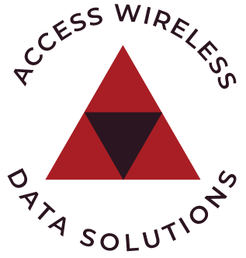
AWDS Booster Solution
Improving cellular coverage is a growing need especially now with 5G
Improved cell quality
Strong reception is no longer a luxury. It’s a requirement.
Enhanced data speeds
Extended coverage areas
Better battery life on connected devices
Increased productivity
Emergency preparedness
Cost savings
Customer satisfaction

Slide 7
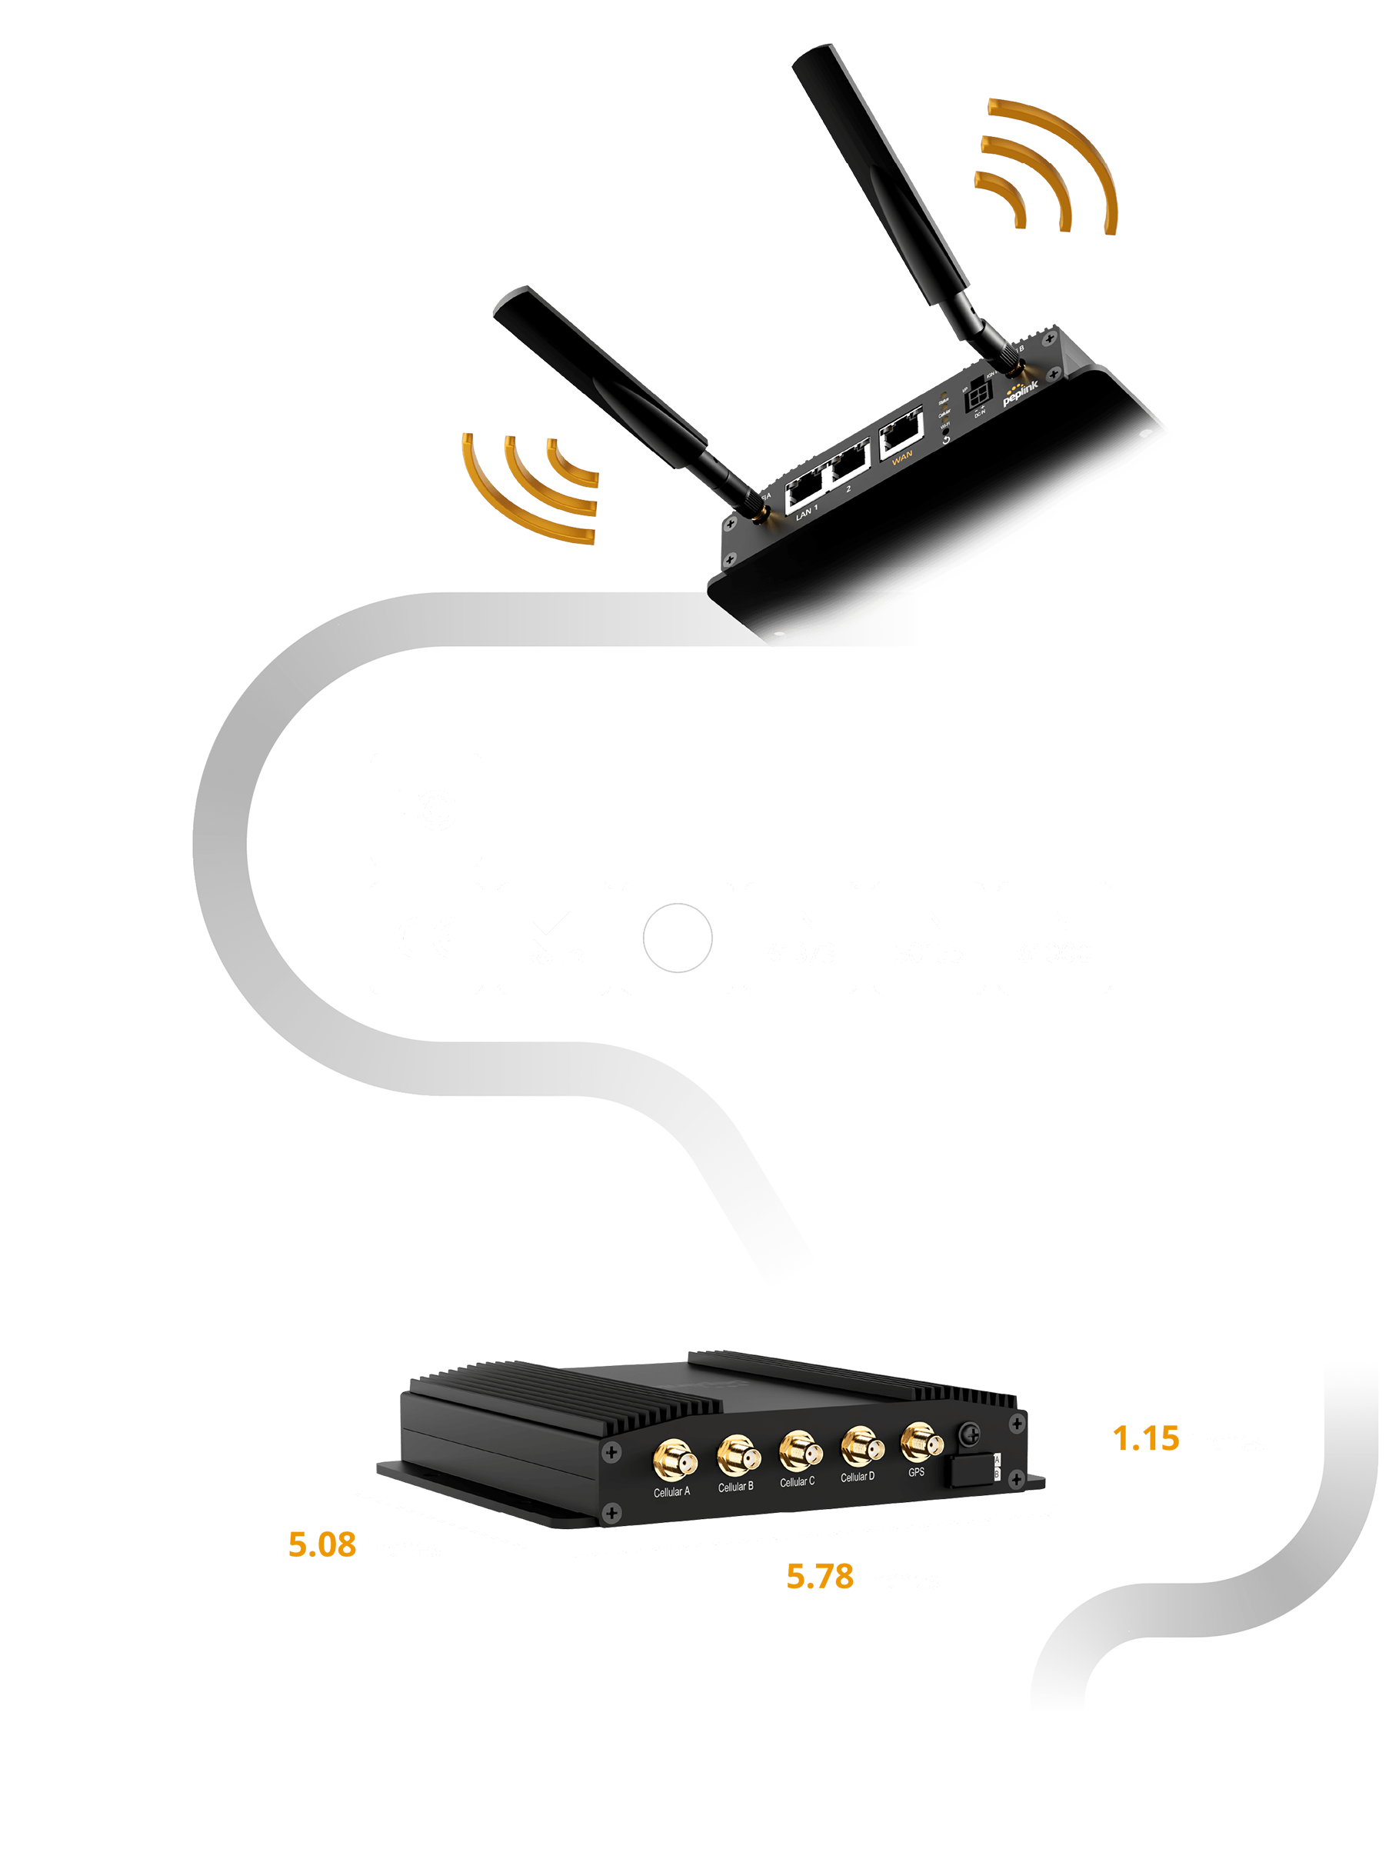
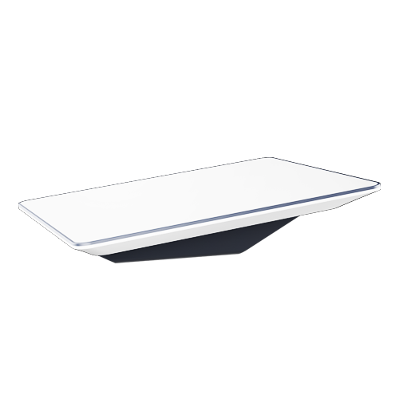
Going 5G with Starlink & T-Mobile
Working on the road
BR1 Pro 5G Mobile Router with an external high gain antenna
Providing connectivity while in motion
Combo between Starlink and Cellular ensure that they’re connected at all times
With a T-Mobile 5G SIM, this device will showcase the true performance of the T-Mobile network.
Peplink $999 MSRP
Starlink $2500 MSRP

Slide 8
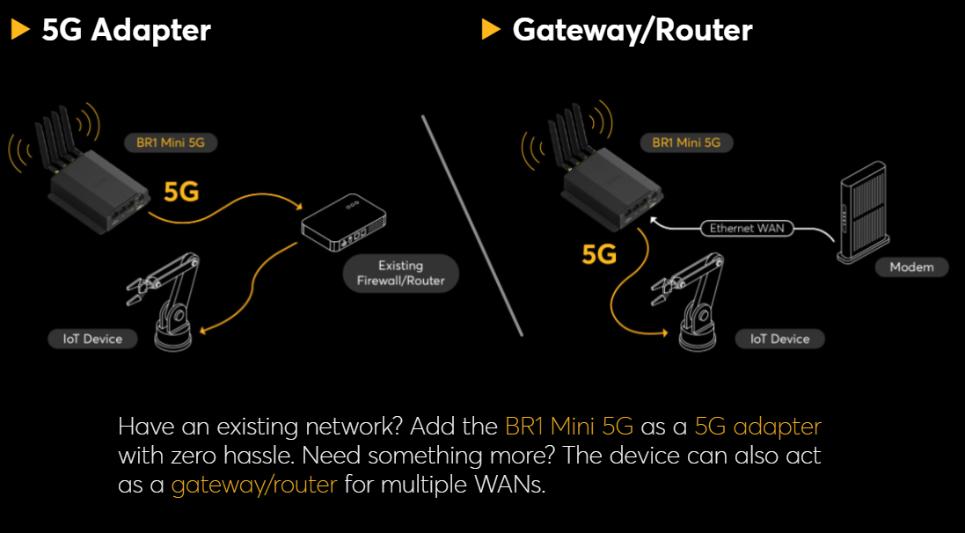
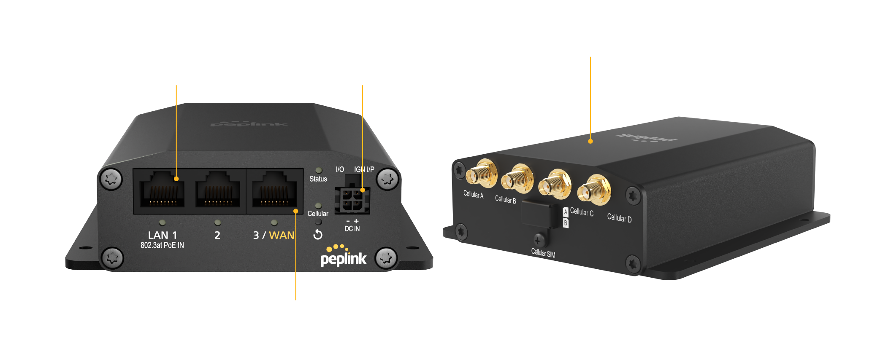
The Power of the MAX BR1 Mini 5G
Priced reasonably - MSRP $499
Cellular only – No GPS or WIFI
Great for ATM, Digital Sign, Cameras, POTS, Kiosks, remote work etc.
Dual SIM
WAN diversity
Compact design
Use as adapter or router

Slide 9
Adapters vs Routers
Routers are the traffic cops telling people which way to go
Controls the flow of data between devices
Adapters are the traffic light just allowing traffic to flow
Allow internet connectivity but no routing
Most routers are black while adapters are white

Slide 10
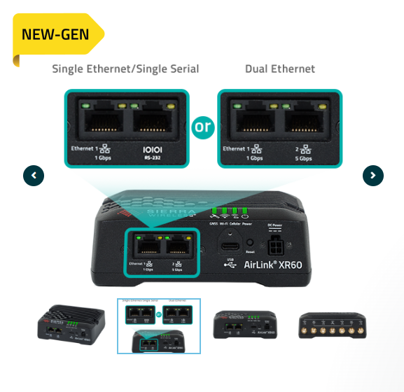
Semtech /Sierra Wireless new 5G
World’s Smallest
Rugged 5G Router
Comes with 5 years of: *ALMS (cloud management)
*Warranty & Support
Good thru EOY

Slide 11
Have you been asked about POTS replacement?

Slide 13
How to work with AWDS?
BRING US ON THE FIRST DISCOVERY CALL!
Discovery Level
We can register the opportunity
You register – we do the rest!
Create the opportunity in SFDC
Check “Partner Teaming” box in the “Partner Teaming Information” section
Select the solution category = routers
Under Device/Solution Details = put as much detail as possible
(AWDS can send qualification form)
Under “Recommended Partner” put AWDS

Slide 14
Visit the AWDS T-Mobile Landing Page
Collateral
Monthly Promo’s
This presentation
Requests for webinars
Territory maps
Discount codes -(T-Mobile - 10% OFF code)
https://accesswds.com/t-mobile-resource-center/

Slide 15
Open floor with Phil
Who struggles with uncovering router opportunities
Do you know the difference between router and adapter
Upgrading to 5G
When to position a booster over access point?
Do you know discovery level questions?
Sale with cell phones and tablets? Do you ask the questions to uncover more?
Do you have a fleet?
Security cameras?
Failover?
Security

Slide 16
Thank you for your Partnership!
Work with a Partner, not just a Vendor
Let’s WIN TOGETHER!

Slide 17
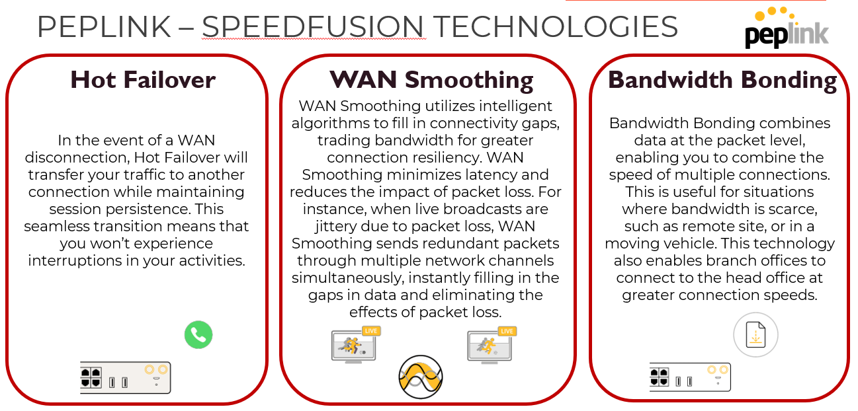
OEM Showcase –
What makes
Peplink different from the rest?

Slide 19
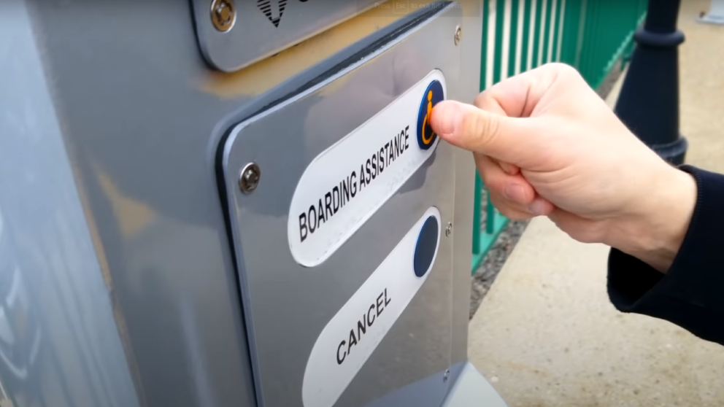
Emergency Communications Solution
Customer:
Emergency communications company.
Request:
To support the passengers of the Long Island Rail Road with 120 Help Points to the NY Metropolitan Transportation Authority (MTA). These emergency kiosks provide 24/7 access to emergency services around station platforms and public areas.
Challenge:
In order to service customers around the clock, the customer needed constant connectivity for their product.
Needed to be small enough to fit in the kiosk itself and be able to withstand weather conditions and temperatures outdoors.
Solution:
AWDS provided the customer with MAX BR1 Mini’s in each emergency kiosk, connected to a Balance router in their server.
Balance router acts as a SpeedFusion Hub and creates a high-availability communications network
In addition all devices are connected to InControl 2, Peplink’s cloud-based endpoint management system.
Result:
Customer was able to provide their emergency kiosks to service many passengers on the Long Island Rail Road 24/7. Peplink’s SpeedFushion technology provided Hot Failover, creating an unbreakable connection which was critical in this application.
“Peplink’s BR1 Mini met our needs at the right price point. [They] let us deploy Help Points anywhere in the world. We can do video, audio, and diagnostics and testing on these Help Points. We can deliver diagnostics back to the customers or to ourselves at Amazon Web Services. Plus, Peplink’s cloud-based device management platform InControl 2 allows us to visualize the whole network from a single location.”
Michael VanBuren, Director of Cloud Solutions

Slide 20
What does synergy mean? Why is it important?
Defined as the combined effort of two or more organisms to produce a greater result than each would have achieved alone.
Mutualistic relationships = synergy
Two perform “services” for each other that they can’t carry alone.

Slide 21
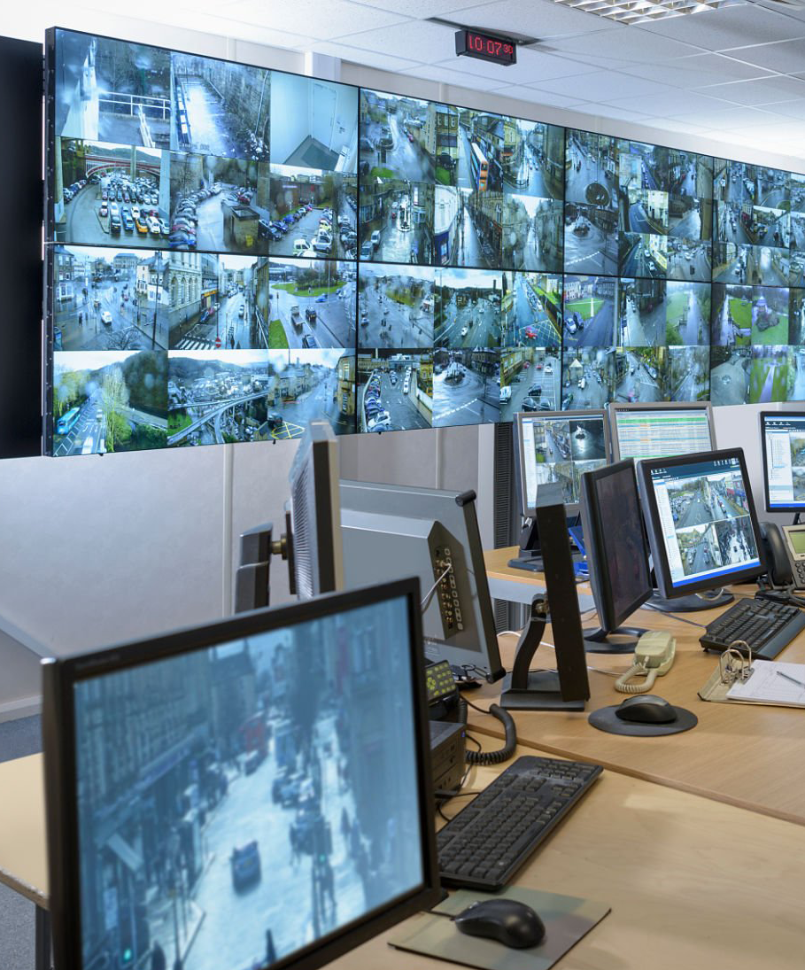
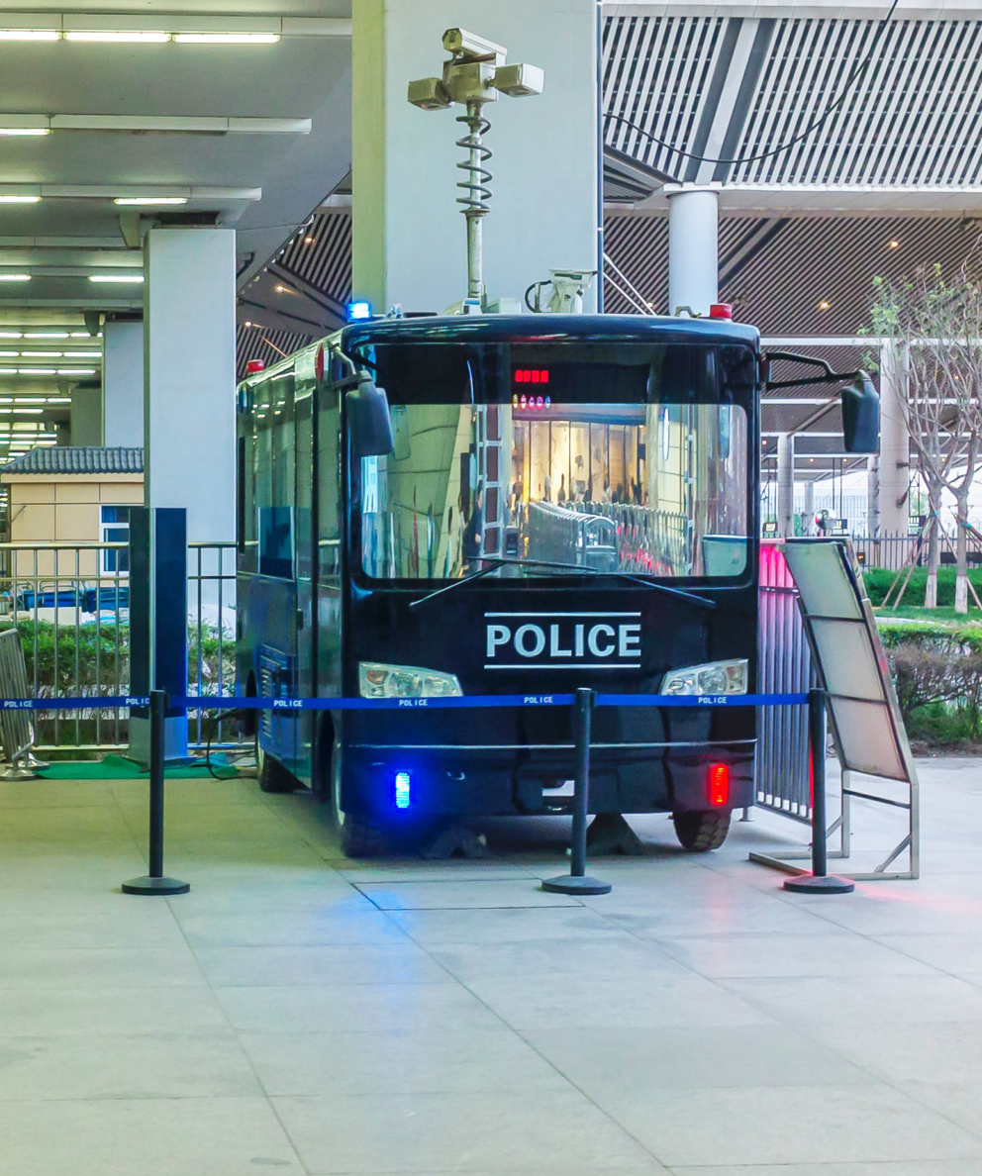
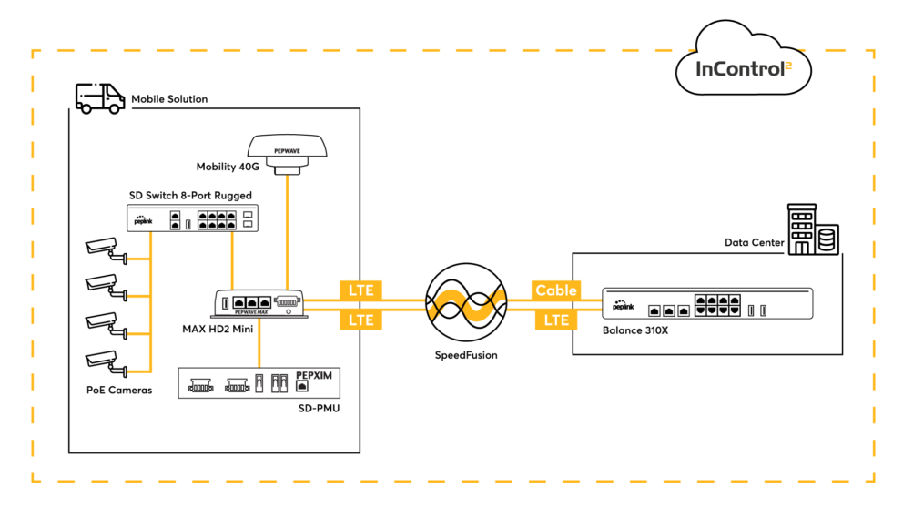
Police Force Surveillance Solution
Customer:
Local police force in North America
Request:
Set up portable security cameras for monitoring.
Flexible network infrastructure to host connections between a data center and remote devices for constant video streaming.
Challenge:
Finding a compact and battery powered solution with remote management- Battery power for cameras.
Device to host up to 4 SIM’s – for: HOT FAILOVER – BANDWIDTH BONDING
Solution:
Mobile solution = Peplink SD-PMU as the power source.
HD2 Mini (dual cellular modems and redundant SIM slots) connected to enable LTE
From router = Peplink SD Switch 8-Port Rugged → connected and powered all of the cameras.
Increase signal = Peplink’s Mobility 40G Antenna was deployed
Result:
Entire solution from one single OEM. One Stop Shop!
SpeedFushion technologies enabled them to be able to load balance and fine-tune traffic flow within the network.
Specific traffic based on priority was assigned to different connections when available.
Resulted in lower latency and increased response time.

Slide 22
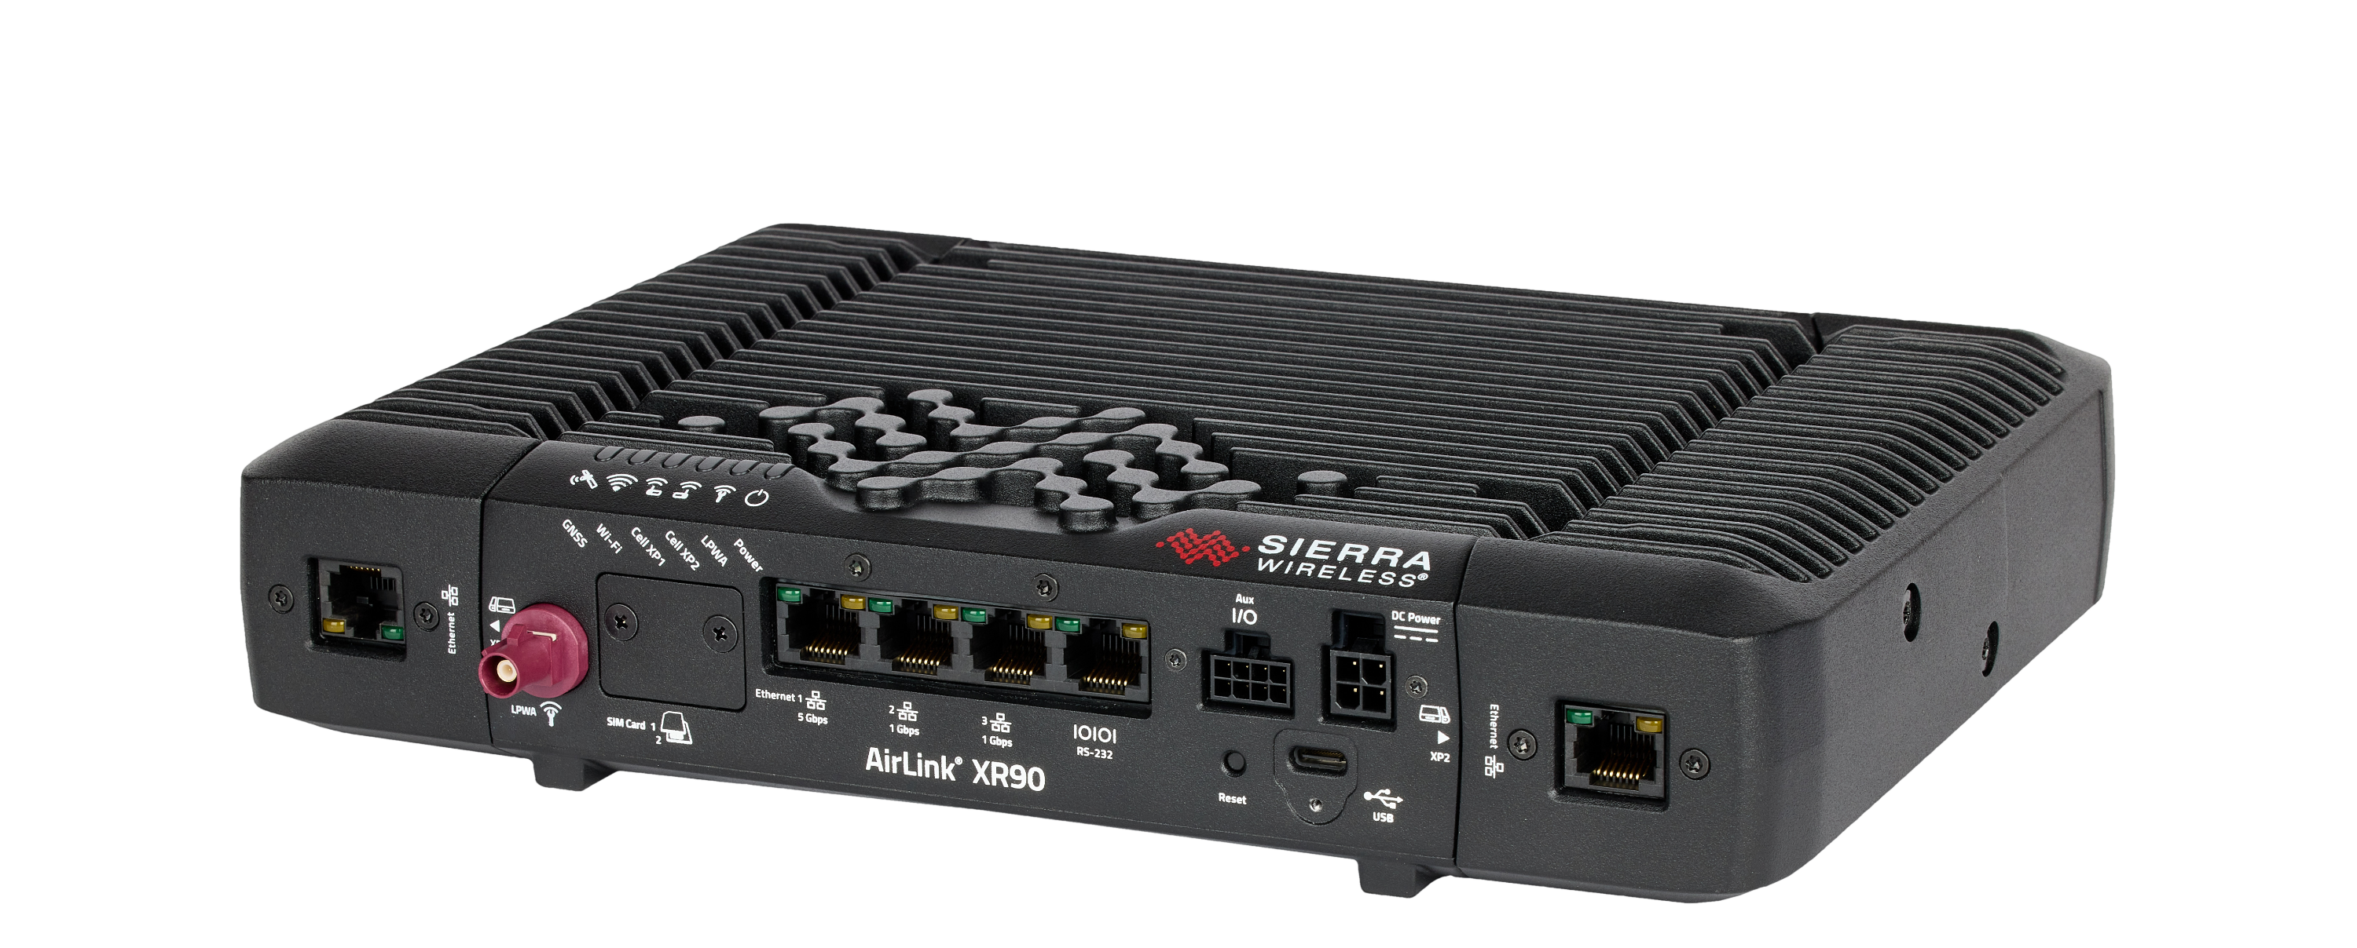
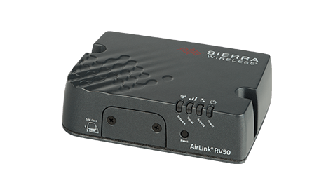
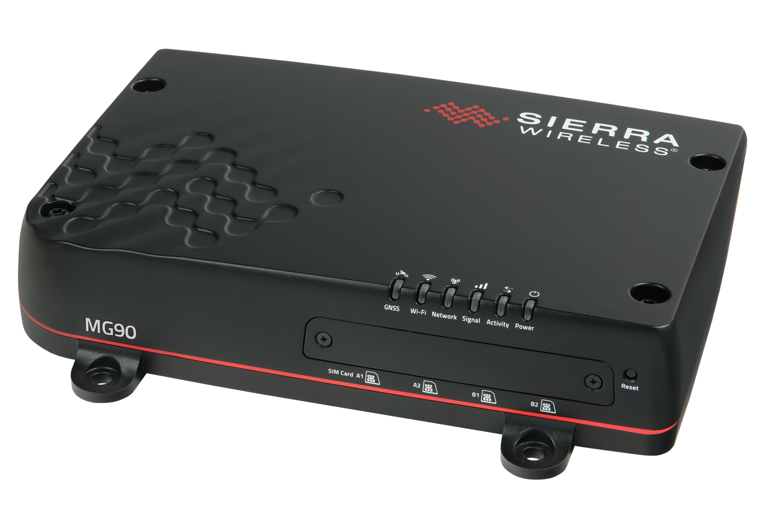
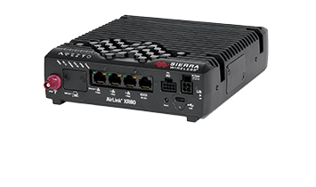
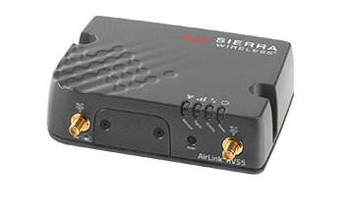
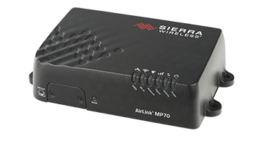
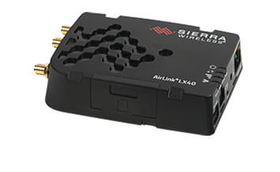
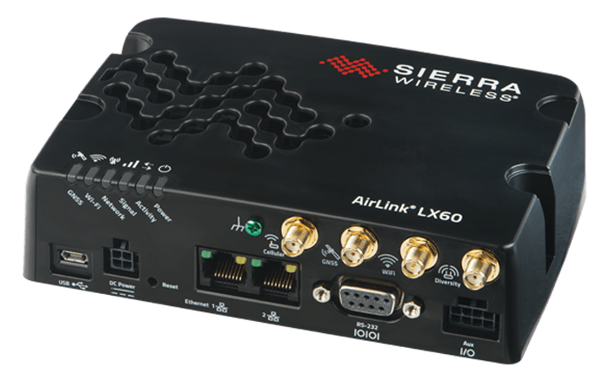
OEM Showcase –
Performance Series
Applications: Industrial IoT, Asset Monitoring, Public Transit, First Responders (Police, Fire, EMS), Oil & Gas, Water, Smart Grid, Video, Transportation
RV50X
RV55
MP70
MG90
XR80
XR90
Essential Series
Applications: IoT/M2M, Building Automation, Digital Signage, Taxi, ATMs, Kiosks, POS Lottery, Backup Connectivity, Smart Locker, IP Camera
LX40
LX60

Slide 24
City Police Department Solution
Customer:
Local City Police department
Request:
Needed a solution to ensure law enforcement officers could respond effectively to calls for service
Enable utility operations to better monitor and manage systems in remote locations
Challenge:
PD and Firefighters were experiencing connectivity problems in their vehicles which was affecting their ability to respond to calls for service.
SCADA systems in Public Works needed to be connected so they could be remotely managed and monitored
IT team was experiencing high volume of calls for support and thus having to either take their vehicles of the street or dispatch support to remote sites to address the problem.
Solution:
Sierra Wireless MP70 was deployed which allowed for the ability to remotely manage and monitor the vehicles and systems.
Result:
IT team is now able to proactively monitor and manage the devices from their office.
Getting fewer support calls, reducing truck rolls
Officers noticed a dramatic difference in increased connectivity.

Slide 25
Local FL City Solution – Smart City (Public Lighting)
Customer:
Local city in Central FL
Request:
Improve maintenance of lighting infrastructure and reduce energy consumption
Challenge:
City had a goal to improve overall maintenance and reduce energy consumption and after looking into tying into fiber optic network, decided that a wireless solution was more cost-effective.
Solution:
A Sierra Wireless MG90 was used to provide remote access and monitoring to 16,000 streetlight fixtures to notify maintenance crews immediately of any problems.
Cut down response time from typically a week to a couple hours
Result:
City was able to be proactive in maintenance and energy efficiency via remote management. Increased energy savings estimated to be at least 35%

Slide 26
What is POTS Line Replacement?
POTS
(Plain Old Telephone Service) line replacement
Process of replacing traditional copper lines with newer technology, such as digital or internet-based systems.
Includes replacing analog telephone lines with digital lines, or replacing traditional telephone infrastructure with internet-based voice over IP (VoIP) systems.
Goal of POTS line replacement:
To improve the reliability and capabilities of telephone service while also reducing costs.

Slide 27
Why Customers Want
Improved call quality: VoLTE uses high-definition voice codecs, which provide better voice quality than traditional circuit-switched voice calls.
Near Instantaneous Dial tone
Lower Latency, Widespread Compatibility with Analog devices that need low latency to function.
No third-party subscriptions or call handling, Carrier is handling the entire call
Carrier Service Licensing Agreement (SLA) is intact, and important for Life Safety applications.
Use the phone number provisioned on the Sim card to make or receive calls.
Secure End to End VoLTE powered Encryption.

Slide 28
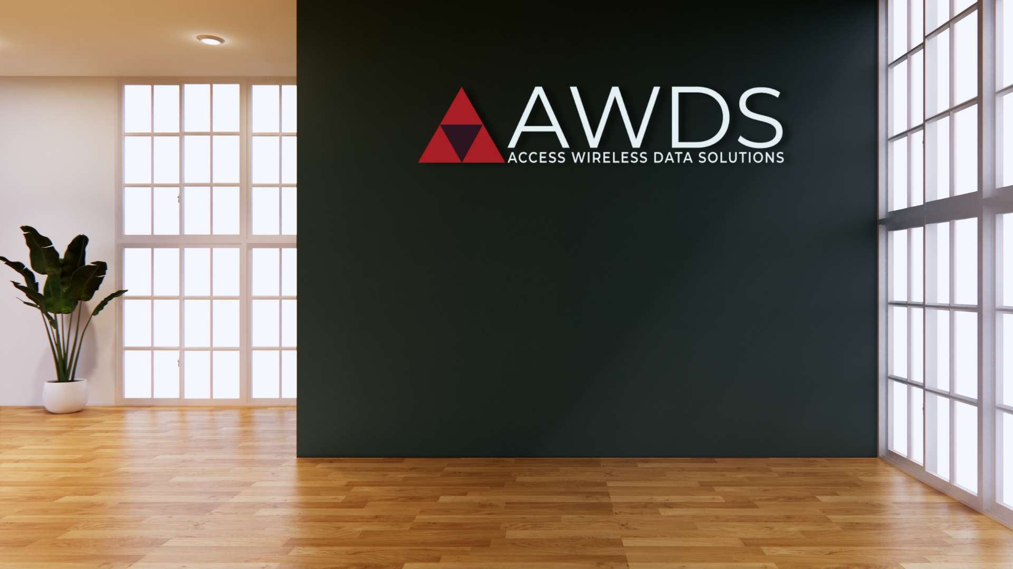
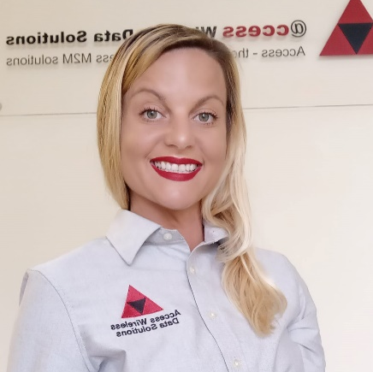
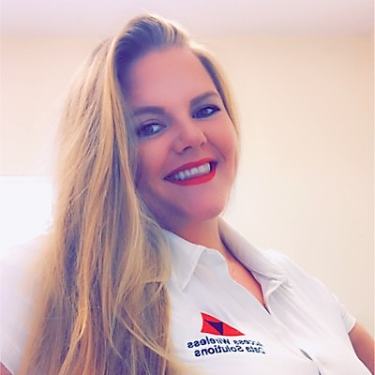
Megan Lynch
Account Manager
North Florida / East Coast US
Public & Commercial
813-751-2039 x111
meganl@accesswds.com
Michelle Guess Hart
Account Manager
South Florida / Central US
Public & Commercial
813-751-2039 x113
michelleg@accesswds.com
Rebecca Meador
Account Manager
Central Florida / West Coast US
Public & Commercial
813-751-2039 x119
rebeccam@accesswds.com

